Slide 1
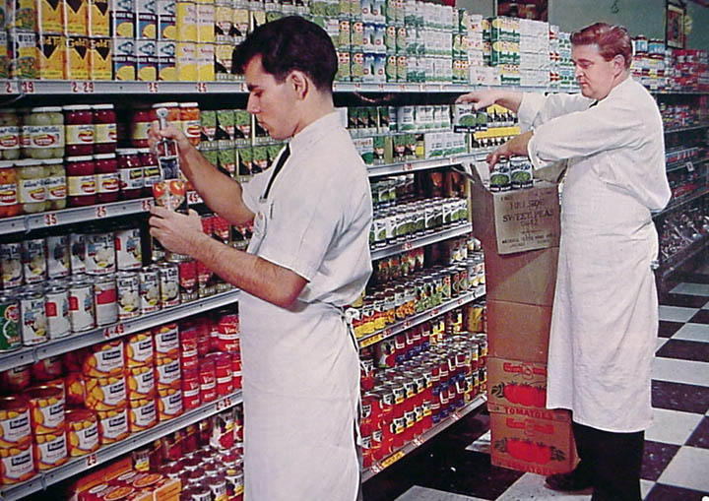
SUPPLY

Slide 2
The Law of SUPPLY
All things being equal,
WHY?
IF
THEN
P
Q
s

Slide 3
SHIFTS in the Supply Curve
What factors would cause a SHIFT in the supply of coffee?
S
$1.25
10
25
40

Slide 4
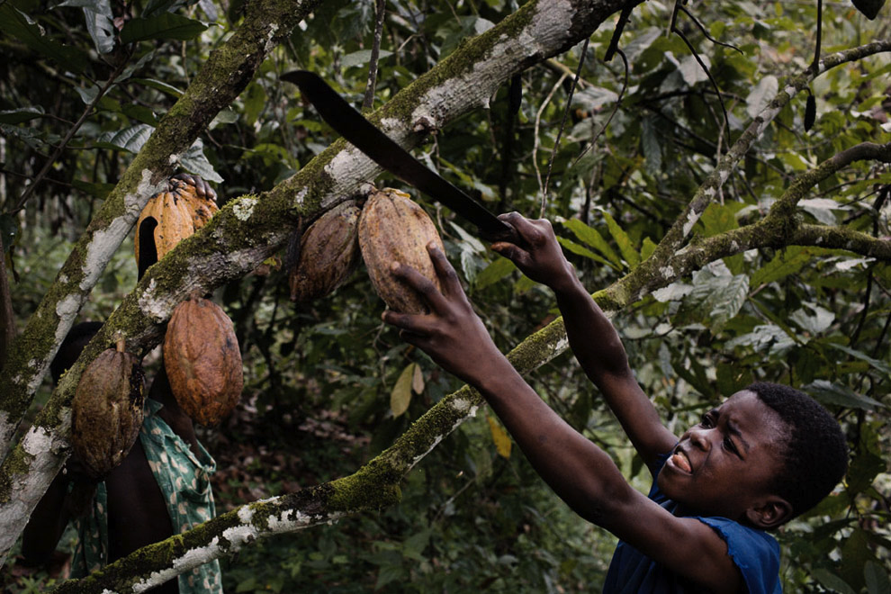
SHIFTS in the Supply Curve
S
Costs
2
S
$1.25
What would happen if the cost of coco beans went up?
18
25
Less coffee is supplied at $1.25

Slide 5
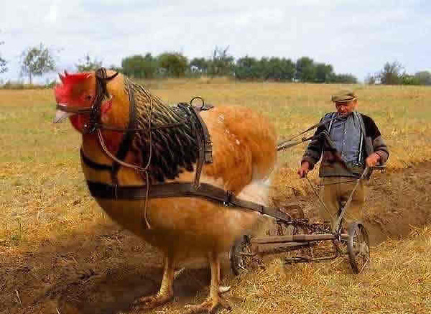
SHIFTS in the Supply Curve
Technology
S
S
2
$1.25
What would happen if the company improved their processing speed?
25
35
More coffee is supplied at $1.25

Slide 6
SHIFTS in the Supply Curve
Government
Subsidies
S
S
2
$1.25
What would happen if the govt gave the company $1 m in grants?
25
35
More coffee is supplied at $1.25

Slide 7
SHIFTS in the Supply Curve
Government
S
2
Taxes
S
$1.25
What would happen if the government increased property taxes?
18
25
Less coffee is supplied at $1.25

Slide 8
SHIFTS in the Supply Curve
Government
S
2
Regulations
S
$1.25
What would happen if the government required coffee to have warning labeling attached?
18
25
Less coffee is supplied at $1.25

