Slide 1
Market Factors that Affect Price
Consumer Perceptions (Image)
Competition
Consumer Demand
Costs and Expenses

Slide 3
Elasticity
How much does price affect your decision?

Slide 4
Law of Demand
The law of demand states…
when price goes down,
demand goes up
when price goes up,
demand goes down…
however,

Slide 5
Law of Demand
…the demand for all products does not respond evenly to changes in price.
How much demand changes is known as:
ELASTICITY

Slide 6
Elasticity
Elastic Demand –
A change in price creates a significant
change in demand
Inelastic Demand –
A change in price creates very little
change in demand

Slide 7
Calculating Elasticity
How do we determine (calculate) if demand for a product is elastic or inelastic?
% change in qty demanded
ELASTICITY =
% change in price
If answer is > 1 = demand is ELASTIC
If answer is < 1 = demand is INELASTIC

Slide 8
Calculating Elasticity
Let’s say the price for shoes increased from $70 to $80
% change in qty demanded
ELASTICITY =
% change in price
$110
ELASTIC
1st Qty - New Qty
x 100
$100
1st Qty
ELASTICITY =
$90
1st $ - New $
x 100
1st $
$80
$70
30 - 20
x 100
33
30
$60
$70 - $80
14
x 100
$70
5
10
15
20
25
30
35
40
2.35
> 1

Slide 9
Calculating Elasticity
Let’s say the price for shoes increased from $70 to $80
% change in qty demanded
ELASTICITY =
% change in price
INELASTIC
$110
1st Qty - New Qty
x 100
$100
1st Qty
ELASTICITY =
$90
1st $ - New $
x 100
1st $
$80
$70
30 - 27
x 100
10
30
$60
$70 - $80
14
x 100
$70
5
10
15
20
25
30
35
40
.714
< 1

Slide 10
Elasticity Factors
Why is the demand for some goods so much less elastic than for other goods?
There are Several Factors:
Availability of Substitutes
Brand Loyalty
Price Relative to Income
Luxury vs. Necessity
Urgency of Purchase

Slide 11
Availability of Substitutes
If substitutes are available, demand is more elastic (demand fluctuates with price)
INELASTIC
ELASTIC
Few Substitutes
Many Substitutes
Demand Constant
Demand Changes

Slide 12
Brand Loyalty
If customer are loyal to one brand, demand is less elastic (demand does not fluctuate with price)
INELASTIC
ELASTIC
HIGH BRAND LOYALTY
LOW BRAND LOYALTY
Demand Constant
Demand Changes

Slide 13
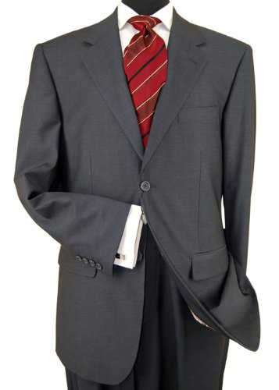
Price Relative to Income
If price has a significant impact on the consumer’s budget, demand is more elastic
INELASTIC
ELASTIC
Low percentage of income
High percentage of income
Demand Constant
Demand Changes

Slide 14
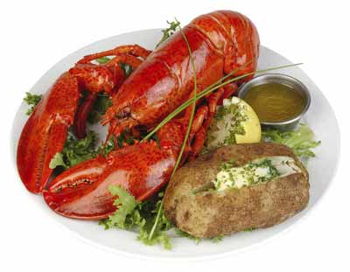
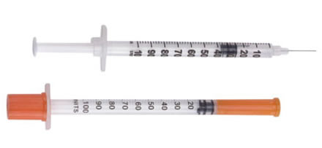
Luxury vs. Necessity
When product is necessary, demand is inelastic
INELASTIC
ELASTIC
Necessity
Luxury
Demand Constant
Demand Changes

Slide 15
Urgency of Purchase
When product is needed immediately, demand is inelastic
INELASTIC
ELASTIC
Urgent
When Convenient
Demand Constant
Demand Changes

