Slide 1
DEMAND

Slide 2
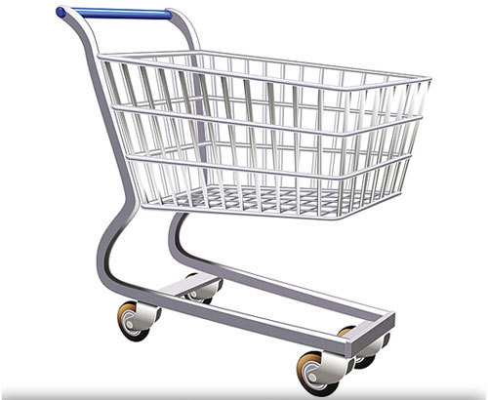
The Law of DEMAND
All things being equal,
WHY?
IF
THEN
P
Q
d

Slide 3
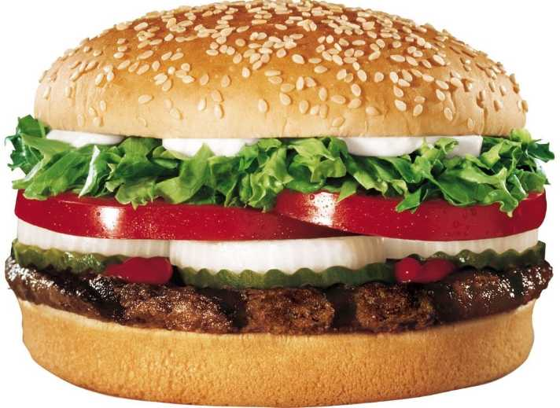
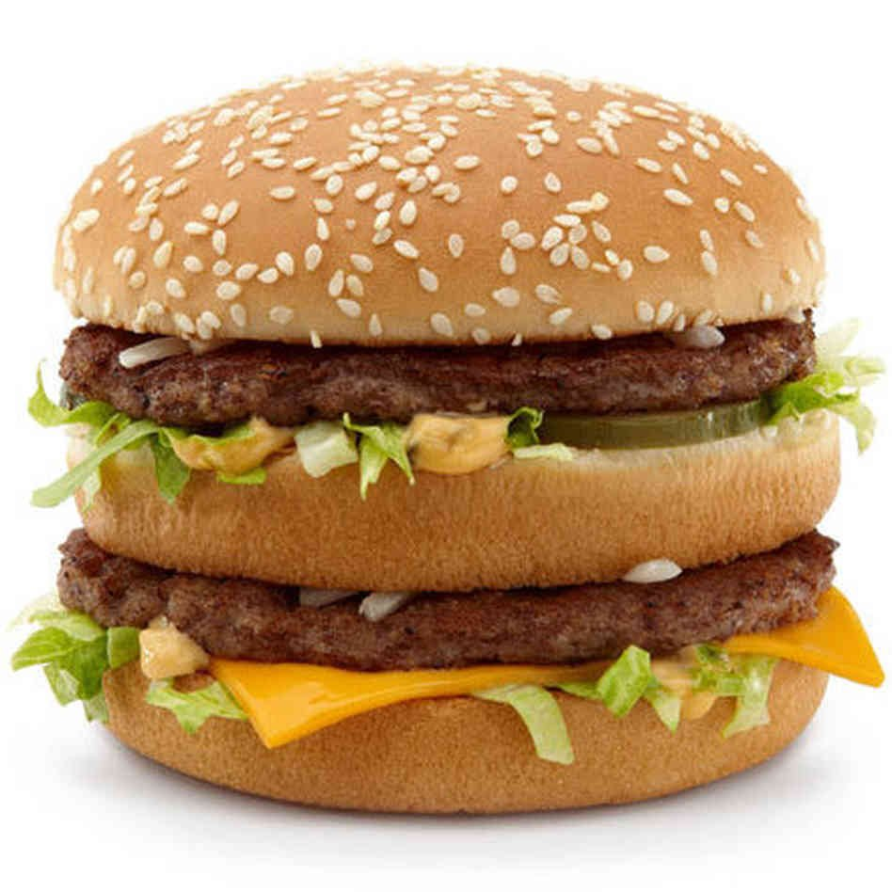
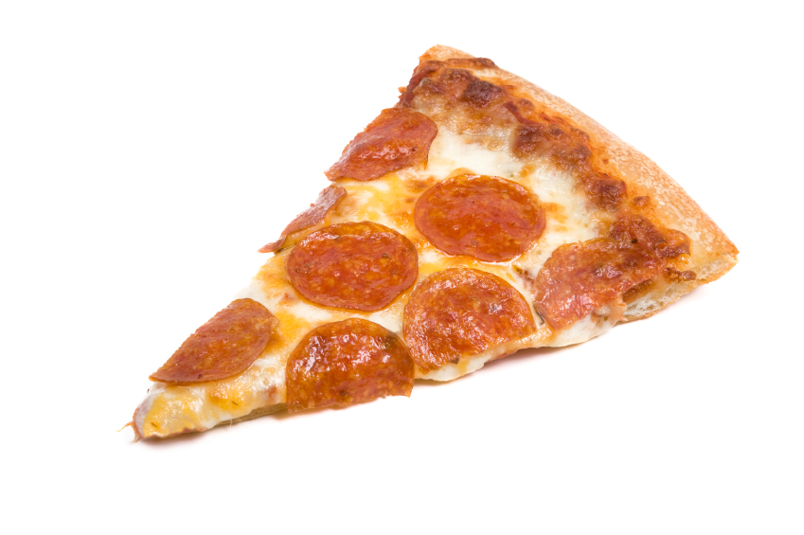
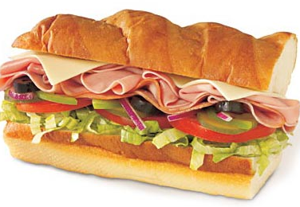
SUBSTITUTION EFFECT
QUANTITY DEMANDEDfor the
Big Mac goes down
P
Q
d

Slide 4
INCOME EFFECT
QUANTITY DEMANDEDfor the
Big Mac goes down
P
Q
d

Slide 5
SHIFTS in the Demand Curve
What factors would cause a SHIFT in the demand for coffee?
$1.25
D
10
25
40

Slide 6
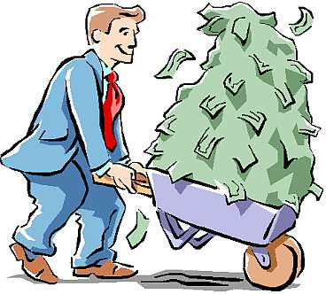
SHIFTS in the Demand Curve
Income
NORMAL
GOOD
$1.25
D
2
What would happen if you receive an increase in income?
D
25
40
More coffee is demanded at $1.25

Slide 7
SHIFTS in the Demand Curve
If you would buy the same amount of a good/service regardless of a change in income you would have a
NEUTRAL GOOD
(perhaps like toilet paper or toothpaste)
Income
INFERIOR
GOOD
$1.25
What would happen if your income were reduced?
D
D
2
10
25
0
Less coffee is demanded at $1.25

Slide 8
SHIFTS in the Demand Curve
Change in Preferences
$1.25
D
2
D
What if you began to enjoy coffee more than before?
25
40
More coffee is demanded at $1.25

Slide 9
SHIFTS in the Demand Curve
Change in Preferences
$1.25
D
D
What if you started to get sick of drinking coffee?
2
10
25
0
Less coffee is demanded at $1.25

Slide 10
SHIFTS in the Demand Curve
Expectations
$1.25
D
What if you knew there was going to be a sale on coffee next week?
D
2
10
25
0
Less coffee is demanded at $1.25

Slide 11
SHIFTS in the Demand Curve
Expectations
$1.25
D
2
What if you knew that a sale on coffee were ending tonight?
D
25
40
More coffee is demanded at $1.25

Slide 12
SHIFTS in the Demand Curve
Price of Related Goods
SUBSTITUTES
$1.25
D
D
2
10
25
0
Less coffee is demanded at $1.25

Slide 13
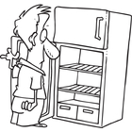
SHIFTS in the Demand Curve
Price of Related Goods
SUBSTITUTES
$1.25
D
2
D
25
40
More coffee is demanded at $1.25

Slide 14
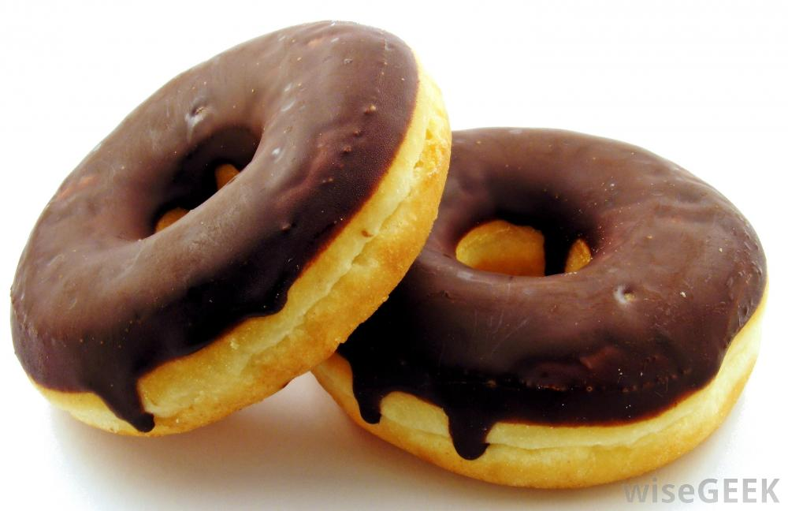
SHIFTS in the Demand Curve
Price of Related Goods
COMPLIMENTS
$1.25
D
2
D
What if the price of donuts went down?
25
40
More coffee is demanded at $1.25

Slide 15
SHIFTS in the Demand Curve
Price of Related Goods
COMPLIMENTS
$1.25
D
D
2
What if the price of donuts went up?
10
25
0
Less coffee is demanded at $1.25

